Slide 1

Data Warehousing and Data Mining III Year / V Semester

Slide 2
Course Outcomes
CO1 - Describe a data warehouse (K2)
CO2 - Apply pre-processing techniques (K3)
CO3 - Interpret correlation based frequent patterns in large data sets (K2)
CO4 - Compare and contrast the various classifiers (K2)
CO5 - Apply data mining techniques and methods to large data sets (K3)

Slide 3
UNIT II
UNIT II – DATA MINING
Data Mining:
Introduction
Kinds of Data and Patterns
Major issues in data mining
Data Objects and attribute types
Statistical description of data
Measuring data similarity and dissimilarity.
Data preprocessing:
Overview-Data cleaning
Data integration
Data reduction
Data transformation and discretization

Slide 4
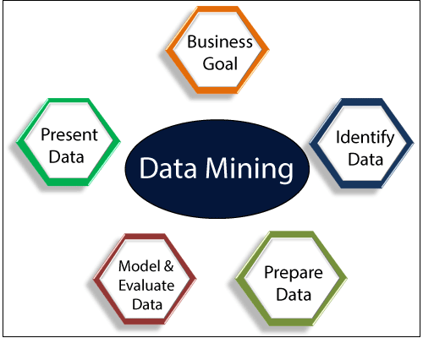
Data Mining: Introduction
The process of extracting information to identify patterns, trends, and useful data that would allow the business to take the data-driven decision from huge sets of data is called Data Mining.
Most useful techniques that help entrepreneurs, researchers, and individuals to extract valuable information from huge sets of data.
Turns raw data into useful information.
Data mining is also called Knowledge Discovery in Database (KDD).

Slide 5
Data Mining: Introduction
The knowledge discovery process includes
Data cleaning,
Data integration,
Data selection,
Data transformation,
Data mining,
Pattern evaluation, and
Knowledge presentation.

Slide 6
Data Mining: Introduction
The knowledge discovery process includes
Data cleaning
to remove noise and inconsistent data
Data integration
where multiple data sources may be combined
Data selection
where data relevant to the analysis task are retrieved from the database
Data transformation
where data are transformed and consolidated into forms appropriate for mining by performing summary or aggregation operations
Data mining
an essential process where intelligent methods are applied to extract data patterns
Pattern evaluation
To identify the truly interesting patterns representing knowledge based on interestingness measures
Knowledge presentation
Where visualization and knowledge representation techniques are used to present mined knowledge to users

Slide 7
KDD Process in Data Mining
Why Data Mining is used in Business? Data mining is used in business to make better managerial decisions by:
Automatic summarization of data
Extracting essence of information stored.
Discovering patterns in raw data.
Data Mining also known as Knowledge Discovery in Databases, refers to the nontrivial extraction of implicit, previously unknown and potentially useful information from data stored in databases.

Slide 8
Steps Involved in KDD Process:

Slide 9
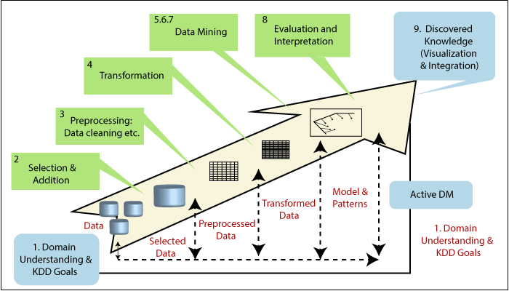
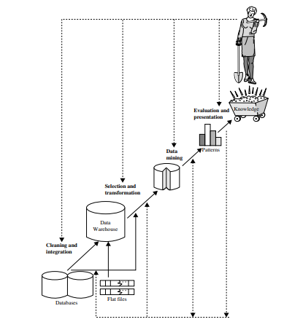

Slide 10
Data Cleaning: Data cleaning is defined as removal of noisy and irrelevant data from collection.
Cleaning in case of Missing values.
Cleaning noisy data, where noise is a random or variance error.
Cleaning with Data discrepancy detection and Data transformation tools.
Data Integration: Data integration is defined as heterogeneous data from multiple sources combined in a common source(DataWarehouse).
Data integration using Data Migration tools.
Data integration using Data Synchronization tools.
Data integration using ETL(Extract-Load-Transformation) process.

Slide 11
Data Integration: Data integration is defined as heterogeneous data from multiple sources combined in a common source(DataWarehouse).
Data integration using Data Migration tools.
Data integration using Data Synchronization tools.
Data integration using ETL(Extract-Load-Transformation) process.
Client 1
Query and Analysis
Data Warehouse
Client 2
Data Source

Slide 12
Data Selection: Data selection is defined as the process where data relevant to the analysis is decided and retrieved from the data collection.
Data Transformation: Data Transformation is defined as the process of transforming data into appropriate form required by mining procedure. Data Transformation is a two step process:
Data Mapping: Assigning elements from source base to destination to capture transformations.
Code generation: Creation of the actual transformation program.

Slide 13
Data Mining: Data mining is defined as clever techniques that are applied to extract patterns potentially useful.
Transforms task relevant data into patterns.
Decides purpose of model using classification or characterization.
Pattern Evaluation: Pattern Evaluation is defined as identifying strictly increasing patterns representing knowledge based on given measures.
Find interestingness score of each pattern.
Uses summarization and Visualization to make data understandable by user.

Slide 14
Knowledge representation: Knowledge representation is defined as technique which utilizes visualization tools to represent data mining results.
Generate reports.
Generate tables.
Generate discriminant rules, classification rules, characterization rules, etc.

Slide 15
Process includes various types of services such as
text mining,
web mining,
audio and video mining,
pictorial data mining, and
social media mining.

Slide 16
Advantages of Data Mining
DM Techniques enables
Organizations to obtain knowledge-based data.
Organizations to make lucrative modifications in operation and production.
DM is a cost-efficient.
DM helps the decision-making process of an organization.
It facilitates the automated discovery of hidden patterns as well as the prediction of trends and behaviors.
It can be induced in the new system as well as the existing platforms.
It is a quick process that makes it easy for new users to analyze enormous amounts of data in a short time.

Slide 17
Disadvantages of Data Mining
There is a probability that the organizations may sell useful data of customers to other organizations for money.
American Express has sold credit card purchases of their customers to other organizations - Report
Many data mining analytics software is difficult to operate and needs advance training to work on.
Different data mining instruments operate in distinct ways due to the different algorithms used in their design.
The selection of the right data mining tools is a very challenging task.
The data mining techniques are not precise, so that it may lead to severe consequences in certain conditions.

Slide 18
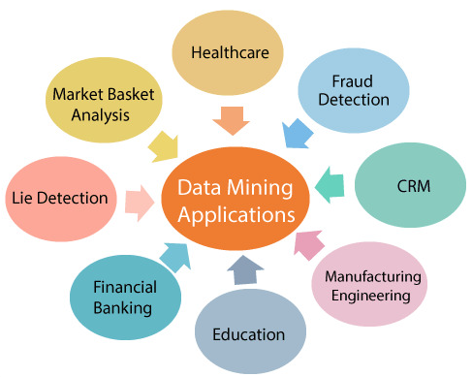
Data Mining Applications
Data Mining is primarily used by organizations with intense consumer demands-
Retail,
Communication,
Financial,
Marketing company,
determine price, consumer preferences, product positioning, and impact on sales, customer satisfaction, and corporate profits.
Data mining enables a retailer to use point-of-sale records of customer purchases to develop products and promotions that help the organization to attract the customer.

Slide 20
Kinds of Data that can be mined
Different kind of data can be mine.
Spatial Databases
Flat Files
Relational Databases
Transactional Databases
Multimedia Databases
Data Warehouse
World Wide Web(WWW)
Time Series Databases

Slide 21
Spatial Database
Used to store geographical information.
Used to store the data in the form of coordinates, lines, and different shapes, etc.
Applications : Maps, Global positioning
Flat files
Flat files are in the binary form or text form and having a structure that can be easily extracted by data mining algorithms.

Slide 22
Relational Databases
Relational Databases is an organized collection of related data.
This organization is in the form of tables with rows and columns.
Different kind of scheme used in relational databases.
A physical and logical schema is famous schema.
In Physical schema - define the structure of tables.
In Logical schema - define a different kind of relationship among tables.
Standard API of the relational database is Structured Query Language (SQL).

Slide 23
Transactional Databases
Transactional databases is an organized collection of data that is organized by timestamps etc.
Example - organized by any date to represent the transaction in databases.
Transactional Databases must have the capability to roll back any transaction.
It is most commonly used in ATM machines
Applications : Object databases, ATM machine, Banking, and Distributed systems

Slide 24
Multimedia Databases
Multimedia databases are the databases that can store the followings;
Video
Images
Audio
Text
Multimedia Databases can be stored on Object-Oriented Databases.
Applications: Ebooks databases, Video websites databases, news websites databases.

Slide 25
Data Warehouse
A data warehouse is the collection of data that is collected and integrated from one or more sources. Later this data can be mined for business decision making.
Three famous types of a data warehouse are mentioned below;
Virtual Warehouse
Data Mart
Enterprise data warehouse
Applications: Business decision making and Data mining

Slide 26
WWW
WWW stands for World wide web. WWW is a collection of documents and resources and can contain a different kind of data like video, audio, and text, etc.
Each data can be identified by Uniform Resource Locators (URLs) through web browsers.
Online tools, online video, images, and text searching sites are the famous applications of WWW.
Time-series Databases
Time-series databases are the databases that can store the stock exchange data etc.
Applications: Graphite and eXtremeDB

Slide 27
Kinds of Patterns Can Be Mined
Data Mining Functionalities
Association
Classification
Clustering
Regression
Prediction

Slide 28
Classification
Separate data based on their properties
Classifying them into multiple classes
Class Label
Example : Classify the countries based on climate

Slide 29
Clustering
Clustering is a data division of information into group of connected objects
Each group is called a cluster
Class Label are not known

Slide 30
Regression
Relationship between various variables
Association
Link between two or more items
Prediction
Analyzing past event or instances data in the right sequence to predict a future event

Slide 31
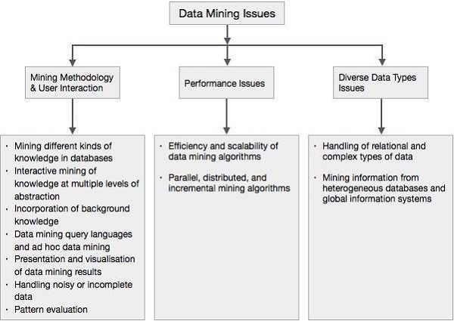
Major issues in Data Mining
Data mining is not an easy task, as the algorithms used can get very complex and data is not always available at one place.
It needs to be integrated from various heterogeneous data sources. These factors also create some issues.
Major issues:
Mining Methodology and User Interaction
Performance Issues
Diverse Data Types Issues

Slide 32
1.Mining Methodology and User Interaction Issues
It refers to the following kinds of issues −
Mining different kinds of knowledge in databases − Different users may be interested in different kinds of knowledge. Therefore it is necessary for data mining to cover a broad range of knowledge discovery task.
Interactive mining of knowledge at multiple levels of abstraction − The data mining process needs to be interactive because it allows users to focus the search for patterns, providing and refining data mining requests based on the returned results.
Incorporation of background knowledge − To guide discovery process and to express the discovered patterns, the background knowledge can be used. Background knowledge may be used to express the discovered patterns not only in concise terms but at multiple levels of abstraction.

Slide 33
Mining Methodology and User Interaction Issues
It refers to the following kinds of issues −
Data mining query languages and ad hoc data mining − Data Mining Query language that allows the user to describe ad hoc mining tasks, should be integrated with a data warehouse query language and optimized for efficient and flexible data mining.
Presentation and visualization of data mining results − Once the patterns are discovered it needs to be expressed in high level languages, and visual representations. These representations should be easily understandable.
Handling noisy or incomplete data − The data cleaning methods are required to handle the noise and incomplete objects while mining the data regularities. If the data cleaning methods are not there then the accuracy of the discovered patterns will be poor.
Pattern evaluation − The patterns discovered should be interesting because either they represent common knowledge or lack novelty.

Slide 34
Performance Issues
There can be performance-related issues such as follows −
Efficiency and scalability of data mining algorithms − In order to effectively extract the information from huge amount of data in databases, data mining algorithm must be efficient and scalable.
Parallel, distributed, and incremental mining algorithms − The factors such as huge size of databases, wide distribution of data, and complexity of data mining methods motivate the development of parallel and distributed data mining algorithms. These algorithms divide the data into partitions which is further processed in a parallel fashion. Then the results from the partitions is merged. The incremental algorithms, update databases without mining the data again from scratch.

Slide 35
Diverse Data Types Issues
Handling of relational and complex types of data − The database may contain complex data objects, multimedia data objects, spatial data, temporal data etc. It is not possible for one system to mine all these kind of data.
Mining information from heterogeneous databases and global information systems − The data is available at different data sources on LAN or WAN. These data source may be structured, semi structured or unstructured. Therefore mining the knowledge from them adds challenges to data mining.

Slide 37
Data Objects and Attribute Types
Data sets are made up of data objects
Data: It is how the data objects and their attributes are stored.
An attribute is an object’s property or characteristics.
For example. A person’s hair colour, air humidity etc.
An attribute set defines an object.
The object is also referred to as a record of the instances or entity.

Slide 38
Data Objects and Attribute Types – Different types
Nominal Attribute
Binary Attribute
Ordinal Attribute
Numeric Attribute
Interval Scaled attribute:
Ratio Scaled attribute:
5. Discrete and Continuous Attribute

Slide 39
Data Objects and Attribute Types – Different types
Nominal Attribute:
Nominal - “relating to names”
Value – “names of thing”
Value – represents kind of category, code, or state
Example
Object : Person
Attributes : Marital Status (single, married, divorced, and widowed)
Occupation (teacher, dentist, programmer, farmer)
Gender (Male, Female) – Code (0 – Male and 1- Female)

Slide 40
Nominal Attributes
Nominal data is in alphabetical form and not in an integer. Nominal Attributes are Qualitative Attributes.
Examples of Nominal attributes
In this example, sates and colors are the attribute and New, Pending, Working, Complete, Finish and Black, Brown, White, and Red are the values.
Attribute Value
Categorical data Lecturer, Assistant Professor, Professor
States New, Pending, Working, Complete, Finish
Colors Black, Brown, White, Red

Slide 41
Data Objects and Attribute Types – Different types
Binary Attribute:
A binary attribute is a nominal attribute with only two categories or states: 0 or 1
where 0 is the absence of any features and 1 is the inclusion of any characteristics.
Example
Gender (Male, Female) – Code (0 – Male and 1- Female)

Slide 42
Binary Attributes
Binary data have only two values/states. For example, here HIV detected can be only Yes or No. Binary Attributes are Qualitative Attributes.
Examples of Binary Attributes
Attribute Value
HIV detected Yes, No
Result Pass, Fail
The binary attribute is of two types;
Symmetric binary
Asymmetric binary

Slide 43
Examples of Symmetric data
Both values are equally important. For example, if we have open admission to our university, then it does not matter, whether you are a male or a female.
Example:
Attribute Value
Gender Male, Female
Examples of Asymmetric data
Both values are not equally important. For example, HIV detected is more important than HIV not detected. If a patient is with HIV and we ignore him, then it can lead to death but if a person is not HIV detected and we ignore it, then there is no special issue or risk.
Example
Attribute Value
HIV detected Yes, No
Result Pass, Fail

Slide 44
Data Objects and Attribute Types – Different types
Ordinal Attribute: The ordinal attribute value provides sufficient information to order the objects.
Examples: Rankings, Grades, Height
grade (e.g., A+, A, A−, B+)
Professional ranks can be enumerated in a sequential
order:
Example: assistant, associate, and full for professors

Slide 45
Ordinal Attributes
All Values have a meaningful order. For example, Grade-A means highest marks, B means marks are less than A, C means marks are less than grades A and B, and so on. Ordinal Attributes are Quantitative Attributes.
Examples of Ordinal Attributes
Attribute Value
Grade A, B, C, D, F
BPS- Basic pay scale 16, 17, 18

Slide 46
Data Objects and Attribute Types – Different types
Numeric attribute:
It is quantitative, such that quantity can be measured and represented in integer or real values, are of two types
Interval Scaled attribute: It is measured on a scale of equal size units, these attributes allows us to compare such as temperature in C or F and thus values of attributes have order.
Example: temperature attribute
Object : Day
Attribute : outdoor temperature for several days
Ratio Scaled attribute:
Is a numeric attribute with an inherent zero-point Both differences and ratios are significant for Ratio.
Example:
Object : Employee
Attribute : YoE

Slide 47
Data Objects and Attribute Types – Different types
Discrete versus Continuous Attributes:
You count discrete data. & You measure continuous data.
A discrete attribute has a finite or countably infinite set of values, which may or may not be represented as integers.
Example: number of books in the library.
number of patients in a hospital
Continuous variables can assume any numeric value and can be meaningfully split into smaller parts
Example: weight, height, length, time, and temperature

Slide 48
Discrete Attributes
Discrete data have a finite value. It can be in numerical form and can also be in a categorical form. Discrete Attributes are Quantitative Attributes.
Examples of Discrete Data
Attribute Value
Profession Teacher, Bussiness Man, Peon etc
Postal Code 42200, 42300 etc

Slide 49
Continuous Attribute
Continuous data technically have an infinite number of steps.
Continuous data is in float type. There can be many numbers in between 1 and 2. These attributes are Quantitative Attributes.
Example of Continuous Attribute
Attribute Value
Height 5.4…, 6.5….. etc
Weight 50.09…. etc

Slide 50
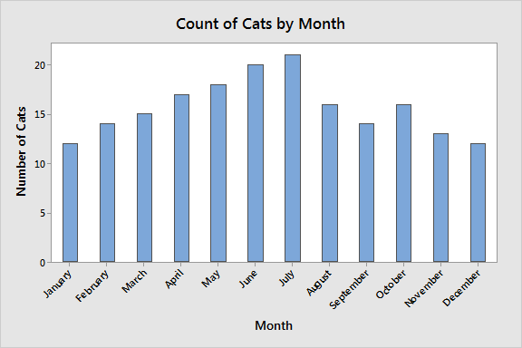
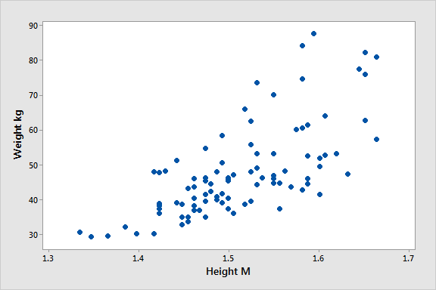

Slide 51
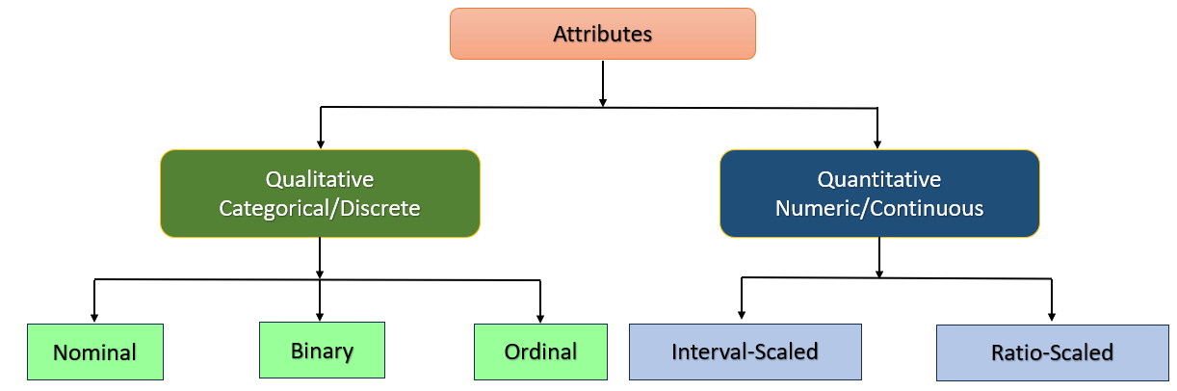
Types of attributes

Slide 52
Statistical Descriptions of Data

Slide 53
Basic Statistical Descriptions of Data
Mean, Median, Mode in data mining
What is mean?
Mean is the average of numbers.
Example:
3, 5, 6, 9, 8
Mean = all values/Total number of values
Mean = 3+5+6+9+8/5
Mean = 6.2

Slide 54
What is Median?
Median is the middle value among all values.
How to calculate the median for an odd number of values?
Example:
9, 8, 5, 6, 3
Arrange values in order
3, 5, 6, 8, 9
Median = 6
How to calculate median for an even number of values?
Example:
9, 8, 5, 6, 3, 4
Arrange values in order
3, 4, 5, 6, 8, 9
Add 2 middle values and calculate their mean.
Median = 5+6/2
Median = 5.5

Slide 55
What is Mode?
The mode is the most occurring value.
How to calculate mode?
Example:
3, 6, 6, 8, 9
Mode = 6 (because 6 is occurring 2 times and all other values occur only one time).

Slide 56
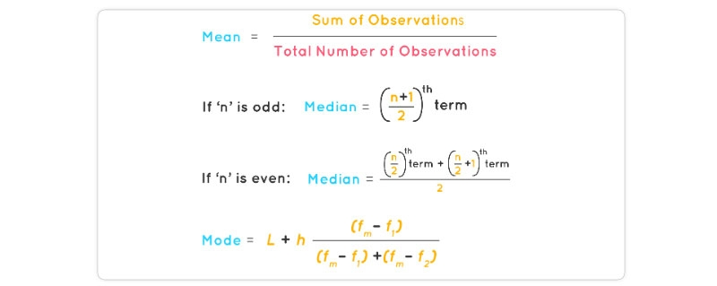

Slide 57
What is quartile?
Quartile means four equal groups.
How to find quartiles of odd length data set?
Example: Data = 8, 5, 2, 4, 8, 9, 5
Step 1:
Arrange the values in order.
Data = 2, 4, 5, 5, 8, 8, 9
[quads id=1]
Step 2:
For dividing this data into four equal parts, Need three quartiles.
Q1: Lower quartile
Q2: Median of the data set
Q3: Upper quartile
Step 3:
Find the median of the data set and label it as Q2.
Data = 2, 4, 5, 5, 8, 8, 9
Q1: 4 – Lower quartile
Q2: 5 – Middle quartile
Q3: 8 – Upper quartile
Inter Quartile Range= Q3 – Q1
= 8 – 4
= 4

Slide 58
What is Outlier?
The outlier is the set of data far away from the common and famous pattern.
How to find outliers?
Outlier is mostly a value higher or lower than 1.5 * IQR
=1.5 * IQR
=1.5 * 5
= 7.5
Population size:
Population size is the total number of values in data.
[quads id=2]

Slide 59
Data = 2, 4, ♦ 5, 5, ♦ 7, 8 ♦ 8, 9
Minimum: 2
Q1: 4 + 5 / 2 = 4.5 Lower quartile
Q2: 5+ 7 / 2 = 6 Middle quartile
Q3: 8 + 8 / 2 = 8 Upper quartile
Maximum: 9
Inter Quartile Range= Q3 – Q1
= 8 – 4.5
= 3.5
Outlier is mostly a value higher or lower than 1.5 * IQR
=1.5 * IQR
=1.5 * 3.5
= 5.25

Slide 60
Variance and standard deviation of data in data mining
Different values in the data set can be spread here and there from the mean. Variance tells us that how far away are the values from the mean.
Standard deviation is the square root of the variance.
Low standard deviation
Low standard deviation tells us that fewer numbers are far away from the mean.
High standard deviation
High standard deviation tells us that more numbers are far away from the mean.

Slide 61
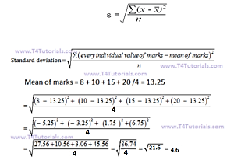
How to calculate variance and standard deviation of a population data?
Mean = 13.25
Variance = 21.6
Standard deviation = 4.6
marks
8
10
15
20

Slide 62
Data Similarity and dissimilarity

Slide 63
Data Similarity and dissimilarity
Clusters of customer objects
with similar characteristics
Example : similar income, area of residence, and age
A cluster is a collection of data objects such that the objects within a cluster are similar to one another and dissimilar to the objects in other clusters

Slide 64
Data Similarity and dissimilarity
A similarity measure for two objects, i and j, will typically return the value 0 if the objects are unalike. The higher the similarity value, the greater the similarity between objects.
A dissimilarity measure works the opposite way. It returns a value of 0 if the objects are the same (and therefore, far from being dissimilar). The higher the dissimilarity value, the more dissimilar the two objects are

Slide 65
Measuring Data Similarity and dissimilarity
Distance or similarity measures are essential in solving many pattern recognition problems such as classification and clustering.
Various distance/similarity measures are available in the literature to compare two data distributions. As the names suggest, a similarity measures how close two distributions are. For multivariate data complex summary methods are developed to answer this question.
Similarity Measure
Numerical measure of how alike two data objects often fall between 0 (no similarity) and 1 (complete similarity)
Dissimilarity Measure
Numerical measure of how different two data objects are range from 0 (objects are alike) to (objects are different)
Proximity
refers to a similarity or dissimilarity

Slide 66
Similarity measure
is a numerical measure of how alike two data objects are.
higher when objects are more alike.
often falls in the range [0,1]
Similarity might be used to identify
duplicate data that may have differences due to typos.
equivalent instances from different data sets. E.g. names and/or addresses that are the same but have misspellings.
groups of data that are very close (clusters)

Slide 67
Dissimilarity measure
is a numerical measure of how different two data objects are
lower when objects are more alike
minimum dissimilarity is often 0 while the upper limit varies depending on how much variation can be
Dissimilarity might be used to identify
outliers
interesting exceptions, e.g. credit card fraud
boundaries to clusters
Proximity refers to either a similarity or dissimilarity

Slide 68
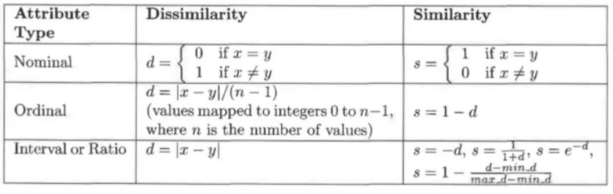

Slide 69
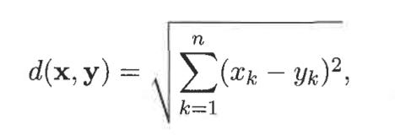
Dissimilarities between Data Objects
Euclidean Distance
The Euclidean distance, d, between two points, x and y, in one, two, three, or higher- dimensional space, is given by the following formula:
where n is the number of dimensions, and x(k) and y(k) are respectively, the kth attributes (components) of x and y.

Slide 70
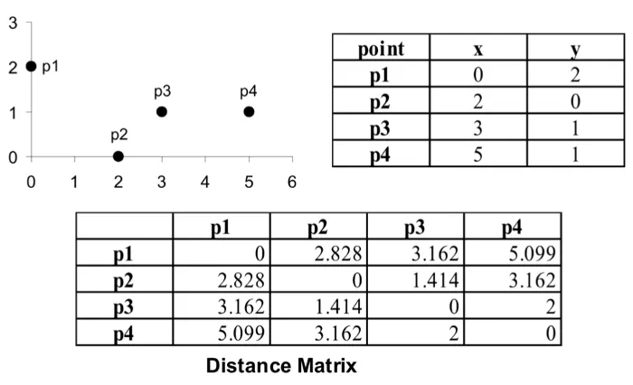

Slide 71
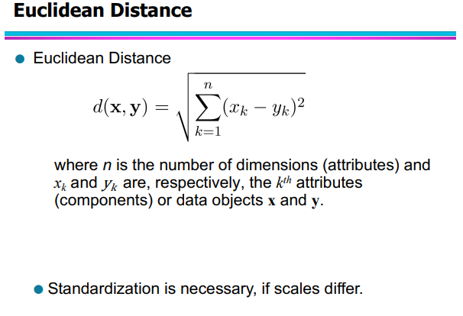

Slide 72
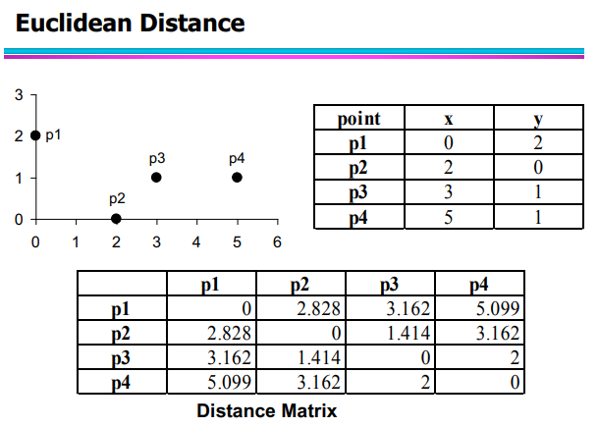

Slide 73
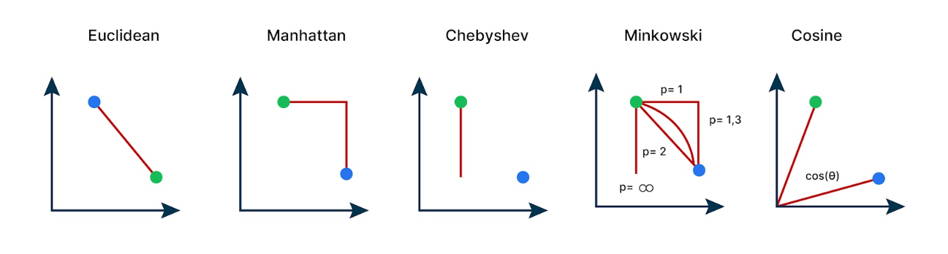

Slide 74
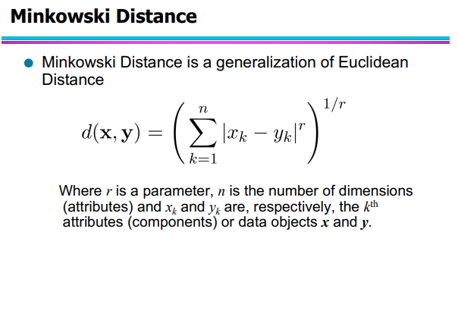

Slide 75
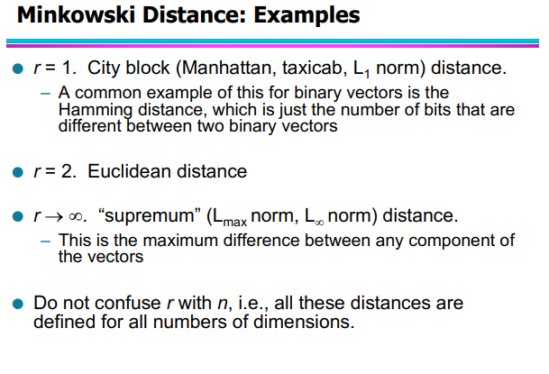

Slide 76
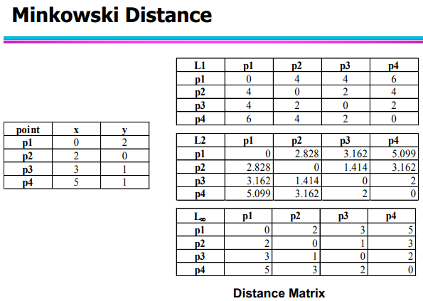

Slide 77
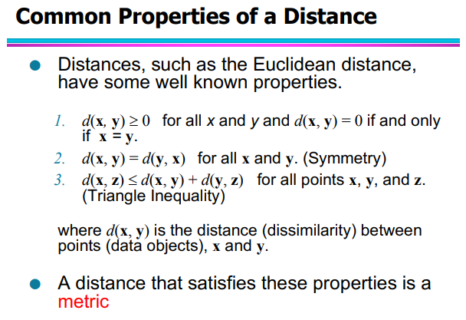

Slide 78
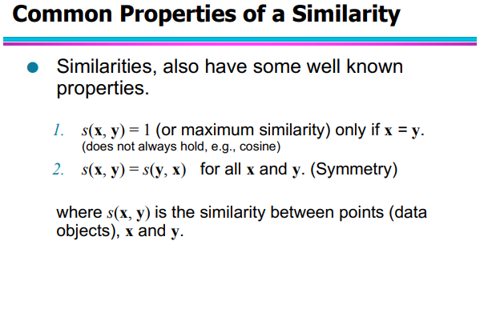
Data mining Measuring similarity and desimilarity | PPT (slideshare.net)

Slide 79
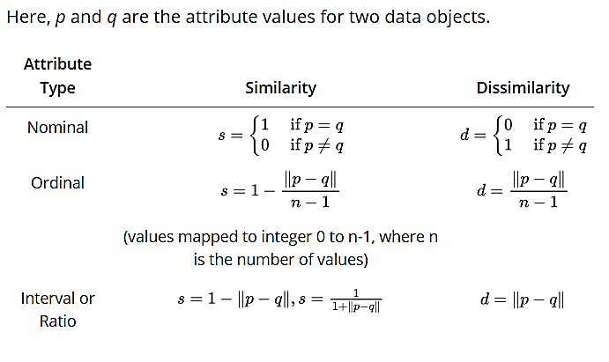
Similarity/Dissimilarity for Simple Attributes

Slide 80
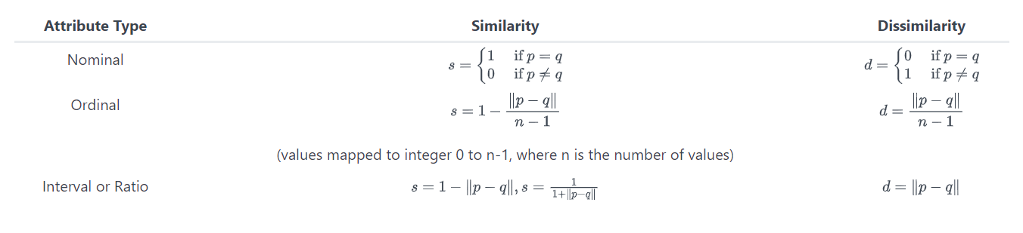
Similarity/Dissimilarity for Simple Attributes
Here, p and q are the attribute values for two data objects.
Distance, such as the Euclidean distance, is a dissimilarity measure and has some well-known properties: Common Properties of Dissimilarity Measures
d(p, q) ≥ 0 for all p and q, and d(p, q) = 0 if and only if p = q,
d(p, q) = d(q,p) for all p and q,
d(p, r) ≤ d(p, q) + d(q, r) for all p, q, and r, where d(p, q) is the distance (dissimilarity) between points (data objects), p and q.
A distance that satisfies these properties is called a metric. Following is a list of several common distance measures to compare multivariate data. We will assume that the attributes are all continuous.

Slide 81
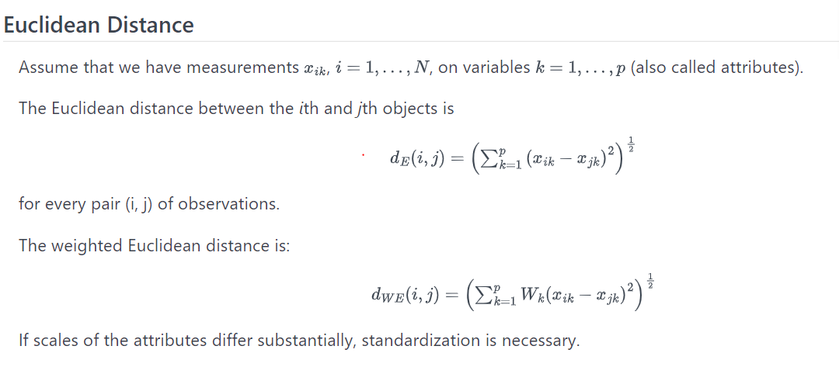
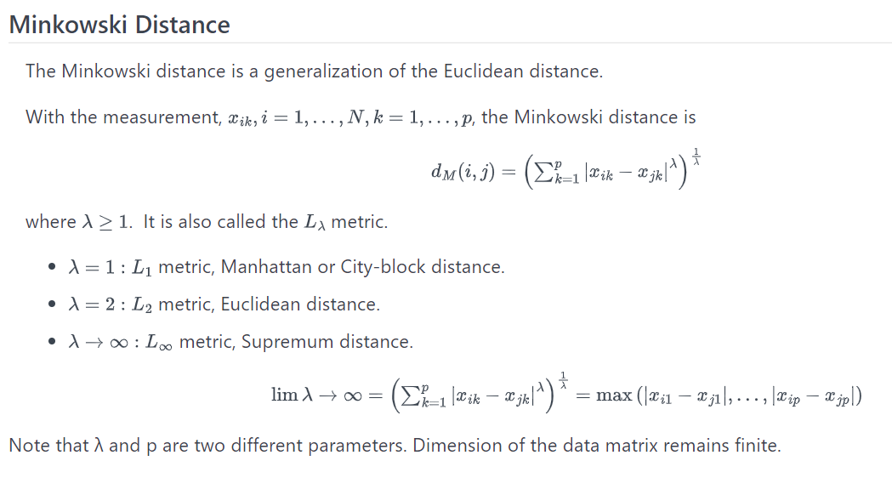

Slide 82
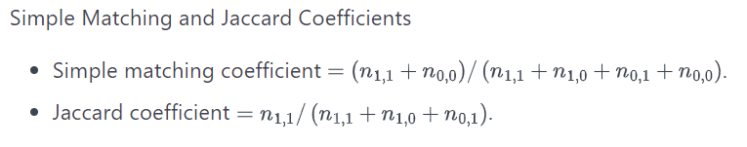
Common Properties of Similarity Measures
Similarities have some well-known properties:
s(p, q) = 1 (or maximum similarity) only if p = q,
s(p, q) = s(q, p) for all p and q, where s(p, q) is the similarity between data objects, p and q.
Similarity Between Two Binary Variables
The above similarity or distance measures are appropriate for continuous variables. However, for binary variables a different approach is necessary.
q=1 q=0
p=1 n1,1 n1,0
p=0 n0,1 n0,0

Slide 83
Example: Calculate the answers to the question and then click the icon on the left to reveal the answer.
Given data:
p = 1 0 0 0 0 0 0 0 0 0
q = 0 0 0 0 0 0 1 0 0 1
The frequency table is:
q=1 q=0
p=1 0 1
p=0 2 7
Calculate the Simple matching coefficient and the Jaccard coefficient.
Simple matching coefficient = (0 + 7) / (0 + 1 + 2 + 7) = 0.7.
Jaccard coefficient = 0 / (0 + 1 + 2) = 0.

Slide 85
DATA PREPROCESSING
Data preprocessing is the process of transforming raw data into an understandable format.
It is also an important step in data mining as we cannot work with raw data.
The quality of the data should be checked before applying machine learning or data mining algorithms.
Why is Data preprocessing important?
Preprocessing of data is mainly to check the data quality. The quality can be checked by the following
Accuracy: To check whether the data entered is correct or not.
Completeness: To check whether the data is available or not recorded.
Consistency: To check whether the same data is kept in all the places that do or do not match.
Timeliness: The data should be updated correctly.
Believability: The data should be trustable.
Interpretability: The understandability of the data.

Slide 86
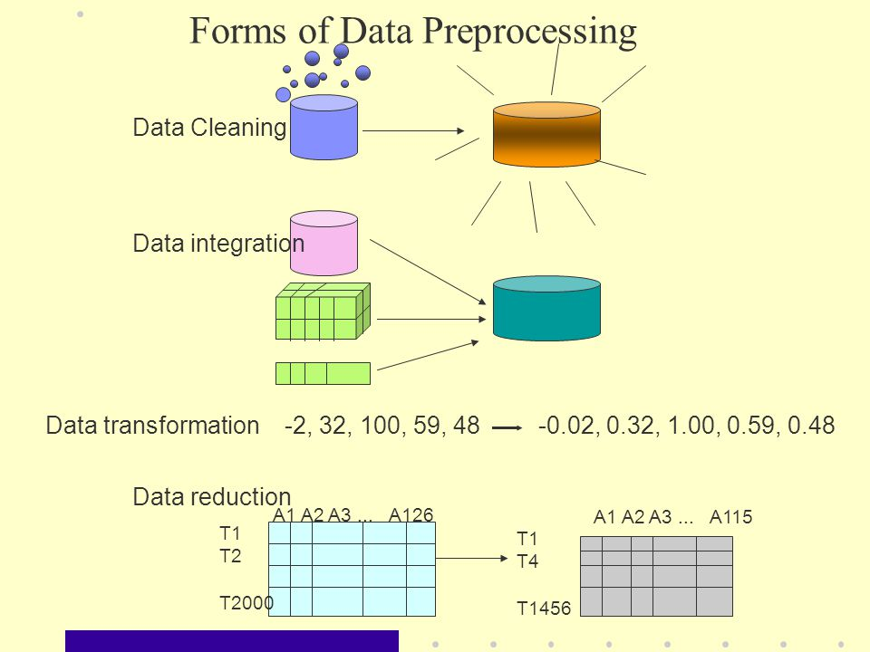

Slide 87
Tasks in data preprocessing
Data Cleaning: It is also known as scrubbing. This task involves filling of missing values, smoothing or removing noisy data and outliers along with resolving inconsistencies.
Data Integration: This task involves integrating data from multiple sources such as databases (relational and non-relational), data cubes, files, etc. The data sources can be homogeneous or heterogeneous. The data obtained from the sources can be structured, unstructured or semi-structured in format.
Data Transformation: This involves normalization and aggregation of data according to the needs of the data set.
Data Reduction: During this step data is reduced. The number of records or the number of attributes or dimensions can be reduced. Reduction is performed by keeping in mind that reduced data should produce the same results as original data.
Data Discretization: It is considered as a part of data reduction. The numerical attributes are replaced with nominal ones.

Slide 88
What is meant by data cleaning
Data cleaning is a process to clean the dirty data. Data is mostly not clean.
It means that most data can be incorrect due to a large number of reasons like due to hardware error/failure, network error or human error. So it is compulsory to clean the data before mining.
What is importance and benefits of data cleaning
1. Data Cleaning removes major errors. 2. Data Cleaning ensures happier customers, more sales, and more accurate decision. 3. Data Cleaning removes inconsistencies that are most likely occur when multiple sources of data are store into one data-set. 4. Data Cleaning make the data-set more efficient, more reliable and more accurate

Slide 89
Sources of Missing Values
There are many sources of missing data. Let’s see some major sources of missing data.
User forgot to fill the data in a field.
It can be a programming error.
Data can be lost when we transferring the data manually from a legacy database.
Dirty data | Examples
Incomplete data | salary=” ”
Inconsistent data | Age =”5 years”, Birthday =”06/06/1990″, Current Year =”2017″
Noisy data | Salary = “-5000”, Name = “123”
Intentional error | Sometimes applications a lot auto value to attribute. e.g some application put gender value as male by default. gender=”male”

Slide 90
How to Handle incomplete/Missing Data?
Ignore the tuple
Fill in the missing value manually
Fill the values automatically by
Getting the attribute mean
Getting the constant value if any constant value is there.
Getting the most probable value by Bayesian formula or decision tree
How to Handle Noisy Data?
Binning
Regression
Clustering
Combined computer and human inspection.

Slide 91
What is Binning?
Binning is a technique in which first of all we sort the data and then partition the data into equal frequency bins.
Types of binning:
There are many types of binning. Some of them are as follows;
Smooth by getting the bin means
Smooth by getting the bin median
Smooth by getting the bin boundaries, etc.
Bin 1 | 2, 3, 6, 8
Bin 2 | 14,16,18,24
Bin 3 | 26,28,30,32
Bin 1 | 4.75, 4.75, 4.75, 4.75
Bin 2 | 18,18,18,18
Bin 3 | 29,29,29,29

Slide 92
Data Integration
In this step, a coherent data source is prepared. This is done by collecting and integrating data from multiple sources like databases, legacy systems, flat files, data cubes etc.
Data is like garbage. You’d better know what you are going to do with it before you collect it. — Mark Twain
Issues in Data Integration
Schema Integration: Metadata (i.e. the schema) from different sources may not be compatible. This leads to entity identification problem. Example : Consider two data sources R and S. Customer id in R is represented as cust_id and in S is represented is c_id. They mean the same thing, represent the same thing but have different names which leads to integration problems. Detecting and resolving them is very important to have a coherent data source.

Slide 93
Data value conflicts: The values or metrics or representations of the same data maybe different in for the same real world entity in different data sources. This leads to different representations of the same data, different scales etc. Example : Weight in data source R is represented in kilograms and in source S is represented in grams. To resolve this, data representations should be made consistent and conversions should be performed accordingly.
Redundant data: Duplicate attributes or tuples may occur as a result of integrating data from various sources. This may also lead to inconsistencies. These redundancies or inconsistencies may be reduced by careful integration of data from multiple sources. This will help in improving the mining speed and quality. Also, co-relational analysis can be performed to detect redundant data.

Slide 94
Data Reduction
If the data is very large, data reduction is performed. Sometimes, it is also performed to find the most suitable subset of attributes from a large number of attributes. This is known as dimensionality reduction. Data reduction also involves reducing the number of attribute values and/or the number of tuples. Various data reduction techniques are:
Data cube aggregation: In this technique the data is reduced by applying OLAP operations like slice, dice or rollup. It uses the smallest level necessary to solve the problem.
Dimensionality reduction: The data attributes or dimensions are reduced. Not all attributes are required for data mining. The most suitable subset of attributes are selected by using techniques like forward selection, backward elimination, decision tree induction or a combination of forward selection and backward elimination.

Slide 95
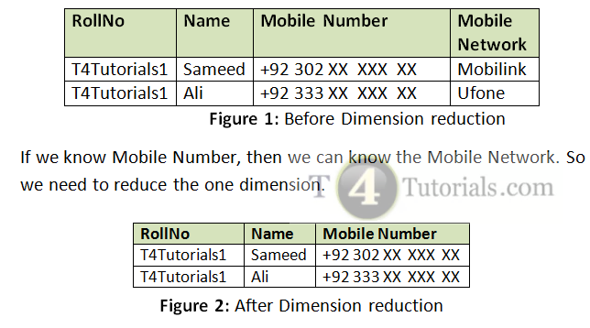
Dimensionality reduction is considered a significant task in data mining applications.
For example, let’s start with an example. Suppose you have a dataset with a lot of dimensions (features or columns in your database).
In this example, we can see that if we know the mobile number, then we can know the mobile network or sim provider. So, we reduce a dimension of mobile network. When we reduce the dimensions, then you can reduce those dimensions of attributes of data by combining the dimensions in such a way that it will not lose significant characteristics of the original dataset that is going to be ready for data mining.

Slide 96
Curse of Dimensionality
“The Curse is an offensive word or phrase used to express anger or annoyance”.
The curse of dimensionality is a condition that occurs when we want to classify, organize, and analyze the high dimensional data.
When the number of dimensions increases, the distance between two independent points increases, and similarity decreases.
This problem results in more errors in our final results after data mining.. When we are working on the data, especially big data, then a very large number of data points are there, so a lot of dimensions are possibly there.
In this case, it’s practically impossible to get the wanted results and even if we suppose that it’s possible then it will give inefficient results.

Slide 97
If we reduce the dimension, then it can be easy and more convenient to collect the data.
Data is not collected only for data mining.
Data accumulates at a good speed.
Data preprocessing is an important task to do for better and effective data mining. 
Dimensionality reduction is an effective approach to collect less data but efficient data.
Dimensionality Reduction is very helpful in the projection of high-dimensional data onto 2D or 3D Visualization.
Dimensionality Reduction is helpful in inefficient storage and retrieval of the data and promotes the concept of Data compression.
Dimensionality Reduction encourages the positive effect on query accuracy by Noise removal.
Dimensionality Reduction reduces computation time. It fastens the time required for performing the same computations.
Dimensionality Reduction is helpful to remove redundant features.

Slide 98
Application of Dimensionality Reduction
Text mining
Image retrieval
Microarray data analysis
Protein classification
Face and image recognition
Intrusion detection
Customer relationship management
Handwritten digit recognition

Slide 99
Data compression: In this technique. large volumes of data is compressed i.e. the number of bits used to store data is reduced. This can be done by using lossy or lossless compression. In loss compression, the quality of data is compromised for more compression. In lossless compression, the quality of data is not compromised for higher compression level.
Numerosity reduction : This technique reduces the volume of data by choosing smaller forms for data representation. Numerosity reduction can be done using histograms, clustering or sampling of data. Numerosity reduction is necessary as processing the entire data set is expensive and time consuming.

Slide 100
Data Transformation:
The change made in the format or the structure of the data is called data transformation. This step can be simple or complex based on the requirements. There are some methods in data transformation.
Smoothing: With the help of algorithms, we can remove noise from the dataset and helps in knowing the important features of the dataset. By smoothing we can find even a simple change that helps in prediction.
Aggregation: In this method, the data is stored and presented in the form of a summary. The data set which is from multiple sources is integrated into with data analysis description. This is an important step since the accuracy of the data depends on the quantity and quality of the data. When the quality and the quantity of the data are good the results are more relevant.

Slide 101
Discretization: The continuous data here is split into intervals. Discretization reduces the data size. For example, rather than specifying the class time, we can set an interval like (3 pm-5 pm, 6 pm-8 pm).
Normalization: It is the method of scaling the data so that it can be represented in a smaller range. Example ranging from -1.0 to 1.0.

Slide 102
Normalizing your data is an essential part of machine learning. You might have an amazing dataset with many great features, but if you forget to normalize, one of those features might completely dominate the others. It’s like you’re throwing away almost all of your information! Normalizing solves this problem. In this article, you learned the following techniques to normalize:
Min-max normalization
Z-score normalization
Decimal Scaling Normalization
Standard Deviation normalization

Slide 103
Min Max Normalization in data mining
Min Max is a data normalization technique like Z score, decimal scaling, and normalization with standard deviation. It helps to normalize the data. It will scale the data between 0 and 1. This normalization helps us to understand the data easily.
For example, if I say you to tell me the difference between 200 and 1000 then it’s a little bit confusing as compared to when I ask you to tell me the difference between 0.2 and 1.
Min Max normalization formula
Min:
The minimum value of the given attribute. Here Min is 8
Max:
The maximum value of the given attribute. Here Max is 20
V: V is the respective value of the attribute. For example here V1=8, V2=10, V3=15, and V4=20
newMax:
1
newMin:
0
marks
8
10
15
20

Slide 104
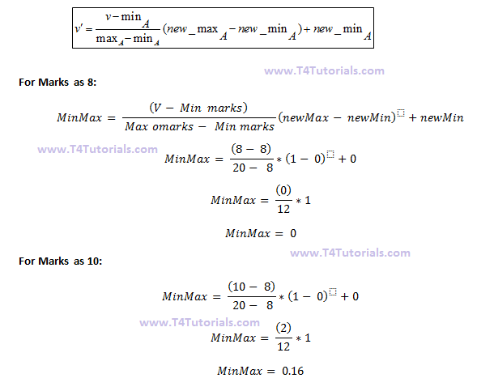
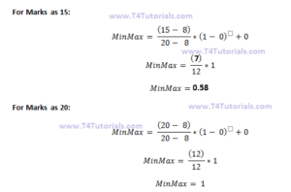
marks | marks after Min-Max normalization
8 | 0
10 | 0.16
15 | 0.58
20 | 1

Slide 105
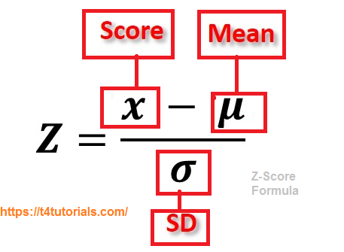
Z-Score Normalization – (Data Mining)
Z-Score helps in the normalization of data. If we normalize the data into a simpler form with the help of z score normalization, then it’s very easy to understand by our brains.
Z- Score Formula

Slide 106
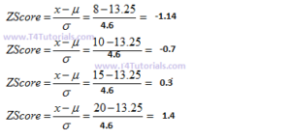
How to calculate Z-Score of the following data?
Mean = 13.25
Standard deviation = 4.6
marks
8
10
15
20
marks | marks after z-score normalization
8 | -1.14
10 | -0.7
15 | 0.3
20 | 1.4

Slide 107
Decimal Scaling Normalization
Decimal scaling is a data normalization technique like Z score, Min-Max, and normalization with standard deviation. Decimal scaling is a data normalization technique. In this technique, we move the decimal point of values of the attribute. This movement of decimal points totally depends on the maximum value among all values in the attribute.
Decimal Scaling Formula
A value v of attribute A is can be normalized by the following formula
Normalized value of attribute = ( vi / 10j )
Example of Decimal scaling
We will check the maximum value among our attribute CGPA. Here maximum value is 3 so we can convert it to a decimal by dividing by 10. Why 10?
we will count total numbers in our maximum value and then put 1 and after 1 we can put zeros equal to the length of the maximum value.
Here 3 is the maximum value and the total numbers in this value are only 1. so we will put one zero after one.
CGPA | Formula | CGPA Normalized after Decimal scaling
2 | 2/10 | 0.2
3 | 3/10 | 0.3

Slide 108
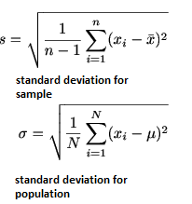
Standard Deviation normalization
Different values in the data set can be spread here and there from the mean. Variance tells us how much far away are the values from the mean.
Standard deviation is the square root of the variance.
High standard deviation tells us that more numbers are far away from the mean.
Low standard deviation tells us that fewer numbers are far away from the mean.

Slide 109
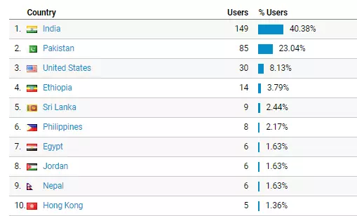
Data discretization in data mining
Data discretization converts a large number of data values into smaller once, so that data evaluation and data management becomes very easy.
Data discretization example
we have an attribute of age with the following values.
Another example is the Website visitor’s data. As seen in the figure below, data is discretized into the countries.
Table: Before discretization
Age | 10,11,13,14,17,19,30, 31, 32, 38, 40, 42,70 , 72, 73, 75
Attribute | Age | Age | Age
 | 10,11,13,14,17,19, | 30, 31, 32, 38, 40, 42 | 70 , 72, 73, 75
After Discretization | Young | Mature | Old

Slide 110
What are some famous techniques of data discretization?
Histogram analysis: Histogram is a plot used to present the underlying frequency distribution of a set of continuous data. The histogram helps the inspection of the data for the distribution of the data. For example normal distribution representation, outliers, and skewness representation, etc.
Binning: Binning is a data smoothing technique and its helps to group a huge number of continuous values into a smaller number of bins. For example, if we have data about a group of students, and we want to arrange their marks into a smaller number of marks intervals by making the bins of grades. One bin for grade A, one for grade B, one for C, one for D, and one for F Grade.
Correlation analysis: Cluster analysis is commonly known as clustering. Clustering is the task of grouping similar objects in one group, commonly called clusters. All different objects are placed in different clusters.
Clustering analysis
Decision tree analysis
Equal width partitioning
Equal depth partitioning

Slide 111
Data discretization and concept hierarchy generation
A concept hierarchy represents a sequence of mappings with a set of more general concepts to specialized concepts. Similarly mapping from low-level concepts to higher-level concepts. In other words, we can say top-down mapping and bottom-up mapping.
Let’s see an example of a concept hierarchy for the dimension location.
Each city can be mapped with the country to which the given city belongs. For example, Mianwali can be mapped to Pakistan and Pakistan can be mapped to Asia.
Top-down mapping
Top-down mapping starts from the top with general concepts and moves to the bottom to the specialized concepts.
Bottom-up mapping
Bottom-up mapping starts from the Bottom with specialized concepts and moves to the top to the generalized concepts.

Slide 112
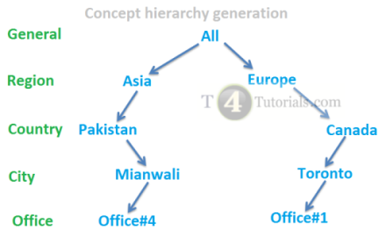
Data discretization and binarization in data mining
what is the difference between discretization and binarization in data science?
Data Discretization in data mining is the process that is used to transform the continuous attributes.
Data Binarization in data mining is used to transform both the discrete and continuous attributes into binary attributes.

Slide 113
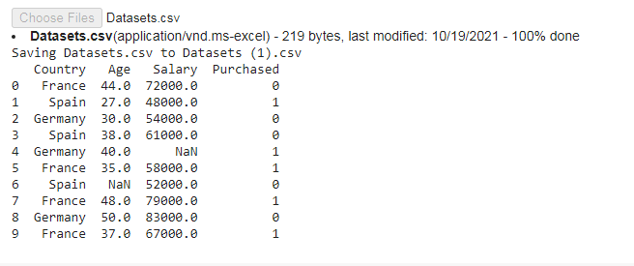
Implementation - Data preprocessing steps
Step 1: Import libraries and the dataset
import pandas as pd
global np
import numpy as np
import io
global df
from google.colab import files
uploaded = files.upload()
df = pd.read_csv(io.BytesIO(uploaded['Datasets.csv']))
print(df)

Slide 114
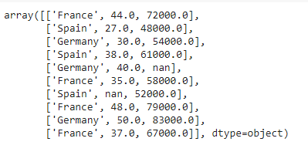

Step 2: Extracting independent variable:
The variables in a study of a cause-and-effect relationship are called the independent and dependent variables.
The independent variable is the cause. Its value is independent of other variables in your study.
The dependent variable is the effect. Its value depends on changes in the independent variable.
global x
x=df.iloc[:,:-1].values
X
Step 3: Extracting dependent variable:
global y
y=df.iloc[:,3].values
y

Slide 115
[:, :] literally means [all rows, all columns].
Indexing in python starts from 0 when you go from the first element to the last, but it starts from -1 when you start from the last element.
So, when you do [:, -1] it means you are taking all the rows and only the last column. -1 represents the last column.
When you do [:, :-1], it means you are taking all the rows and all the columns except the last column.

Slide 116
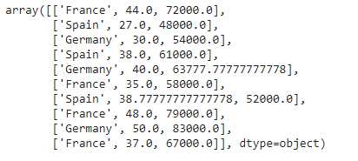
step 4: Filling the missing value with the mean value of the attribute
from sklearn.impute import SimpleImputer
imputer = SimpleImputer(missing_values=np.nan, strategy='mean')
imputerimputer= imputer.fit(x[:, 1:3])
x[:, 1:3]= imputer.transform(x[:, 1:3])
x

Slide 117
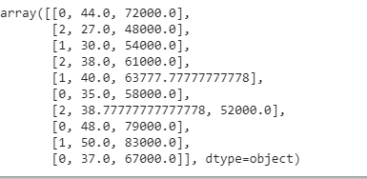
Step 5: Encoding the country variable (Transformation)
The machine learning models use mathematical equations. So categorical data is not accepted so we convert it into numerical form.
from sklearn.preprocessing import LabelEncoder
label_encoder_x= LabelEncoder()
x[:, 0]= label_encoder_x.fit_transform(x[:, 0])
x

Slide 118
End of Unit II

